Slide 1
Picture with auto scroll
Navigation Bar
Flowing information of new batch and offer
Pic of Director
About the Director

Slide 2
Student Review
Video Rating
Video Rating
Video Rating
Video Rating
Our Courses
Course Time
Course Time
Course Time
Course Time

Slide 3
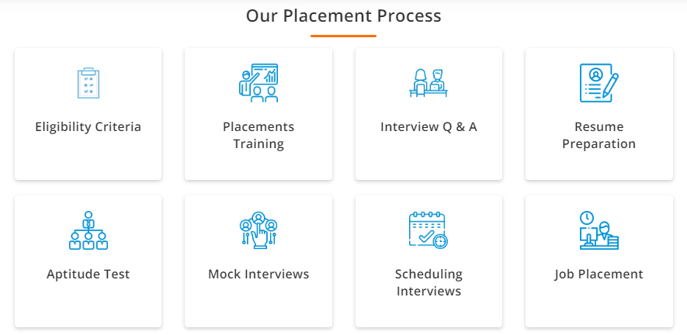


Slide 4
